Slide 1
HILL CIPHER
As time progressed, the study of cryptography began to involve higher level mathematics. With this more advanced math came more advanced ciphers based on the idea of encryption and decryption keys. Encryption keys are a special value or set of values used in an encryption algorithm to convert a plaintext into a cipher text. A decryption key is the opposite. One encryption scheme that utilizes more advanced mathematics, as well as encryption and decryption keys is a cipher from 1929 called the Hill cipher. The Hill cipher is based on matrix multiplication and is a lot more secure than the Caesar cipher that was previously discussed.

Slide 2
Encoding Hill Cipher
Convert letters into numbers
Write message into blocks (matrices) of two
Multiply decoding matrix A with the vectors
Convert numbers into letters
Decoding Hill Cipher
Convert numbers into letters
Multiply decoding matrix 𝐴 −1 with the vectors
Convert numbers into letters
Worksheet on encoding and decoding!

Slide 3
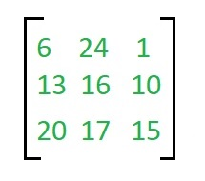

EXAMPLE
Encryption
We have to encrypt the message ‘ACT’ (n=3).The key is ‘GYBNQKURP’ which can be written as the nxn matrix:
The message ‘ACT’ is written as vector:

Slide 4
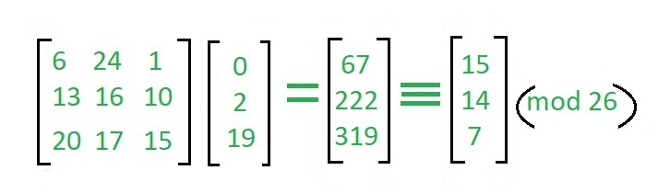
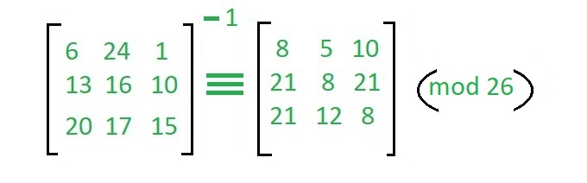
The enciphered vector is given as:
which corresponds to cipher text of ‘POH’
Decryption
To decrypt the message, we turn the ciphertext back into a vector, then simply multiply by the inverse matrix of the key matrix (IFKVIVVMI in letters).The inverse of the matrix used in the previous example is:

Slide 5
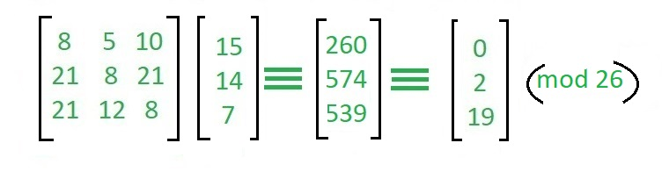
For the previous Cipher text ‘POH’:
which gives us back ‘ACT’. Assume that all the alphabets are in upper case. Below is the implementation of the above idea for n=3.

